Slide 1
Phase I: Work breakdown
Ruslan Salakhutdinov Brandon Houghton

Slide 2
Milestone 1:
Formulate two initial frameworks,
one which includes symmetry-constrained architectures and
the second which includes scale-adapted architectures
Formulate the theory and architecture of operator symmetry families for continuous dynamics and develop architecture (CMU).
Develop theory for rotational symmetry (CMU)
Search for standard architectures and metrics to compare against (CMU)
Develop DNN architecture which solves the symmetry-constrained learning problem (CMU)

Slide 3
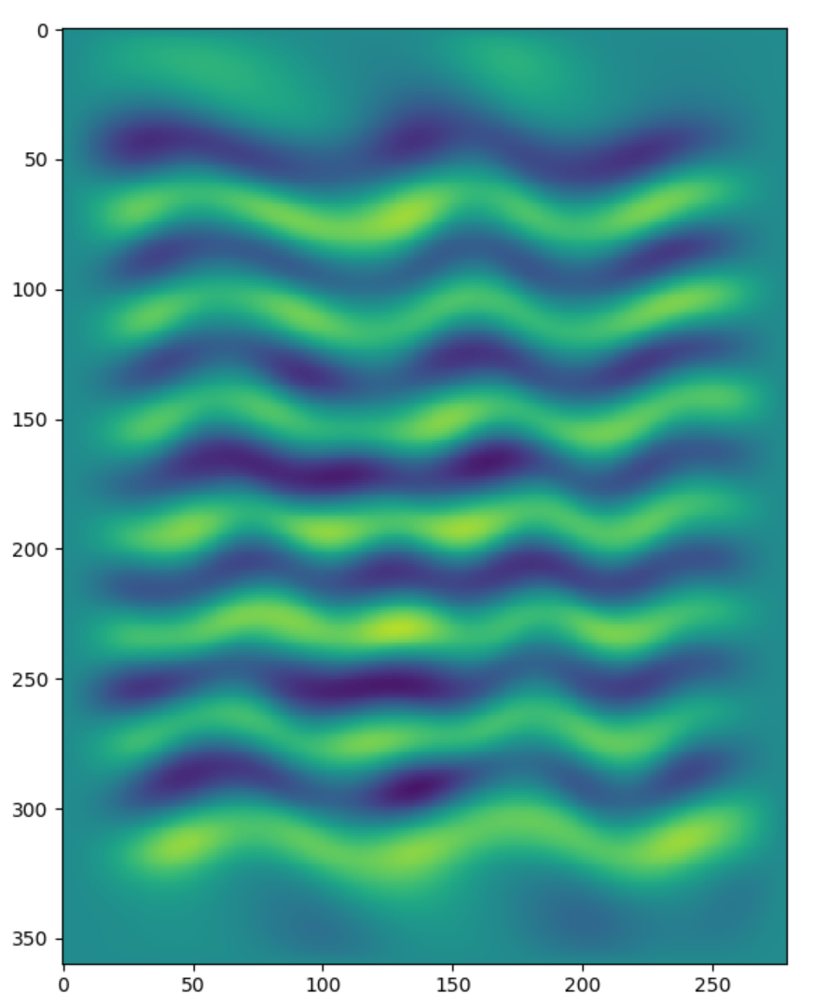
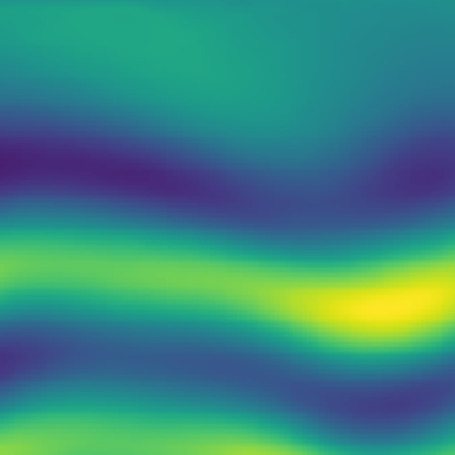
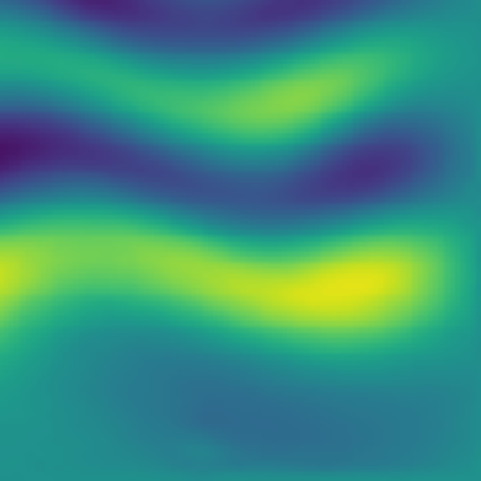
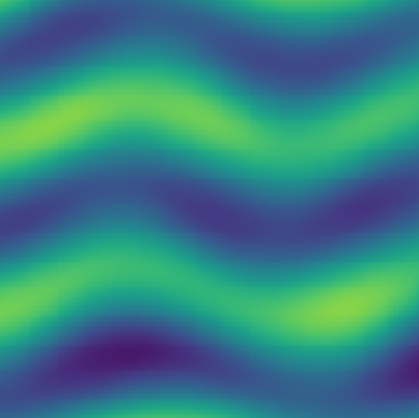
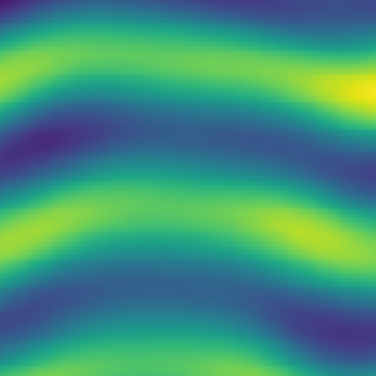
Vorticity data augmentation
Vorticity Data
Sampling Patches
1000 samples
100,000 samples
Neural network can memorize entire sequence.
Not enough samples for train / test split
Neural network can memorize difficult patches.
Train / test split leaves plenty of samples

Slide 4

Vorticity symmetry augmentation
Applying Transformations
Patches
rotation
mirror
100,000 samples
100,000,000,000+ samples

Slide 5
Vorticity scale augmentation (todo as described)
Sampling Patches At various scales
Vorticity Data

Slide 6
Baseline standard architecture
Use linear model to learn dynamics of system.
Results in high error (0.6 MSE)

Slide 7
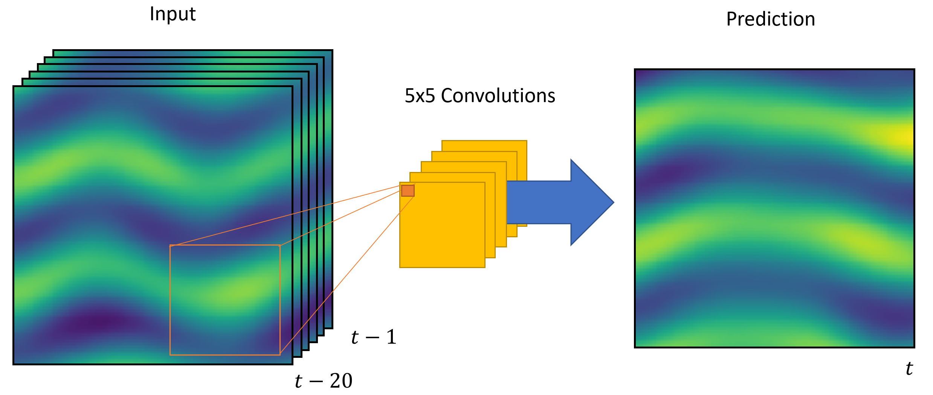
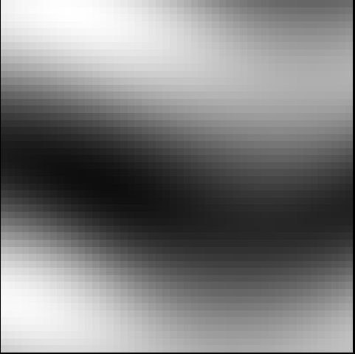
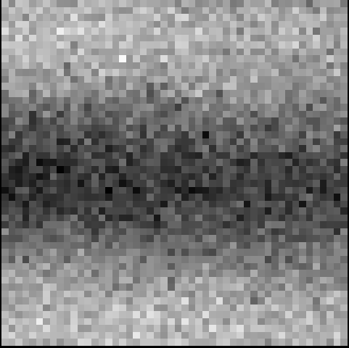
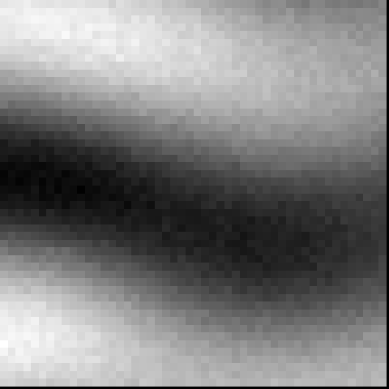
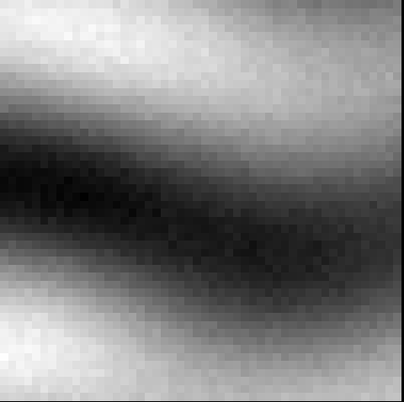
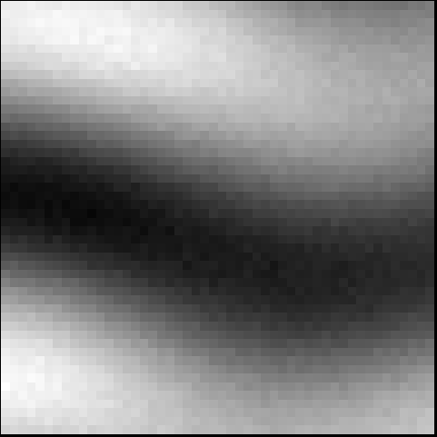
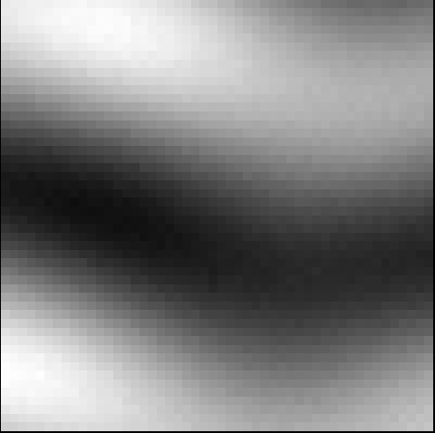
Predicted fixed horizon local vorticity
Developed network architecture for predicting future vorticity
Trained models are capable of predicting the future vorticity field using only local history for a given patch (< 1e-4 MSE)
TODO as described: direct comparison of these models with and without symmetries
Ground Truth
Predicted vorticity across training epochs

Slide 8
Milestone 2:
Investigate model fidelity with respect to amount of training data and noisy or missing training data
Formulate a constrained learning problem which determines a generative model which respects the known symmetries (JH, CMU).
Separate rotational and time symmetry (JH, CMU).
Compare with existing architectures (JH, CMU).
Investigate model fidelity and compare performance with respect to the amount of training data
Investigate model fidelity and compare performance with respect to noisy data.

Slide 9
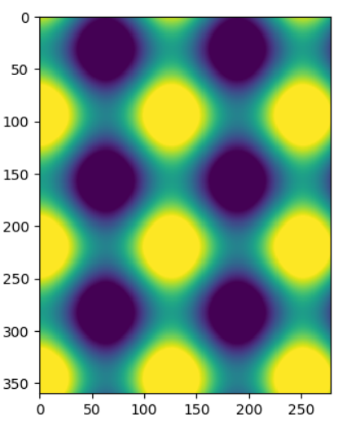
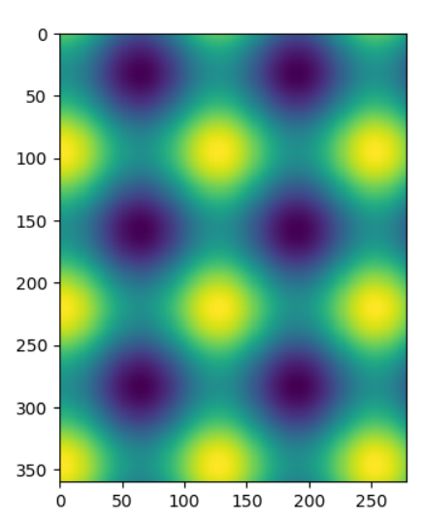
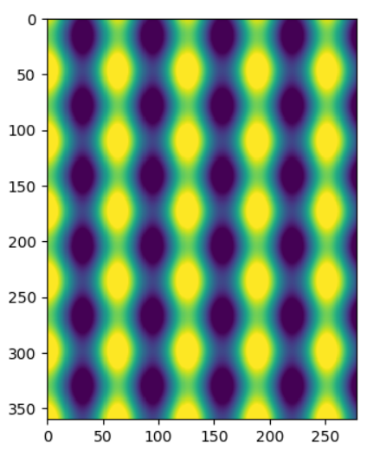
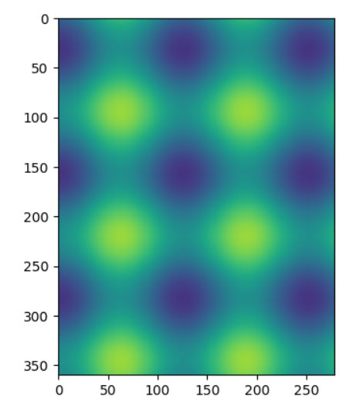
Periodic field comparison
Simple periodic field simulation for learning procedure benchmark
Enables comparison of noisy turbulence data with pure periodic data
Low-dimensionality allows for smaller auto-encoder layers enabling faster testing and development

Slide 10
Limit training examples / data
Direct comparison between number of provided samples
1200 non-overlapping samples of 50x50x(20+20) patches
Evaluate model performance using:
500 samples
5000 samples
50000 trajectories
ToDo as described

Slide 11
Missing training data
Validation accuracy performance
Learned models showed robustness to validation samples not included in training set

Slide 12
Milestone 3:
Apply architectures to determine generative models from turbulence data (JH, CMU)
Included in previous milestones
Compare with existing architectures

Slide 13
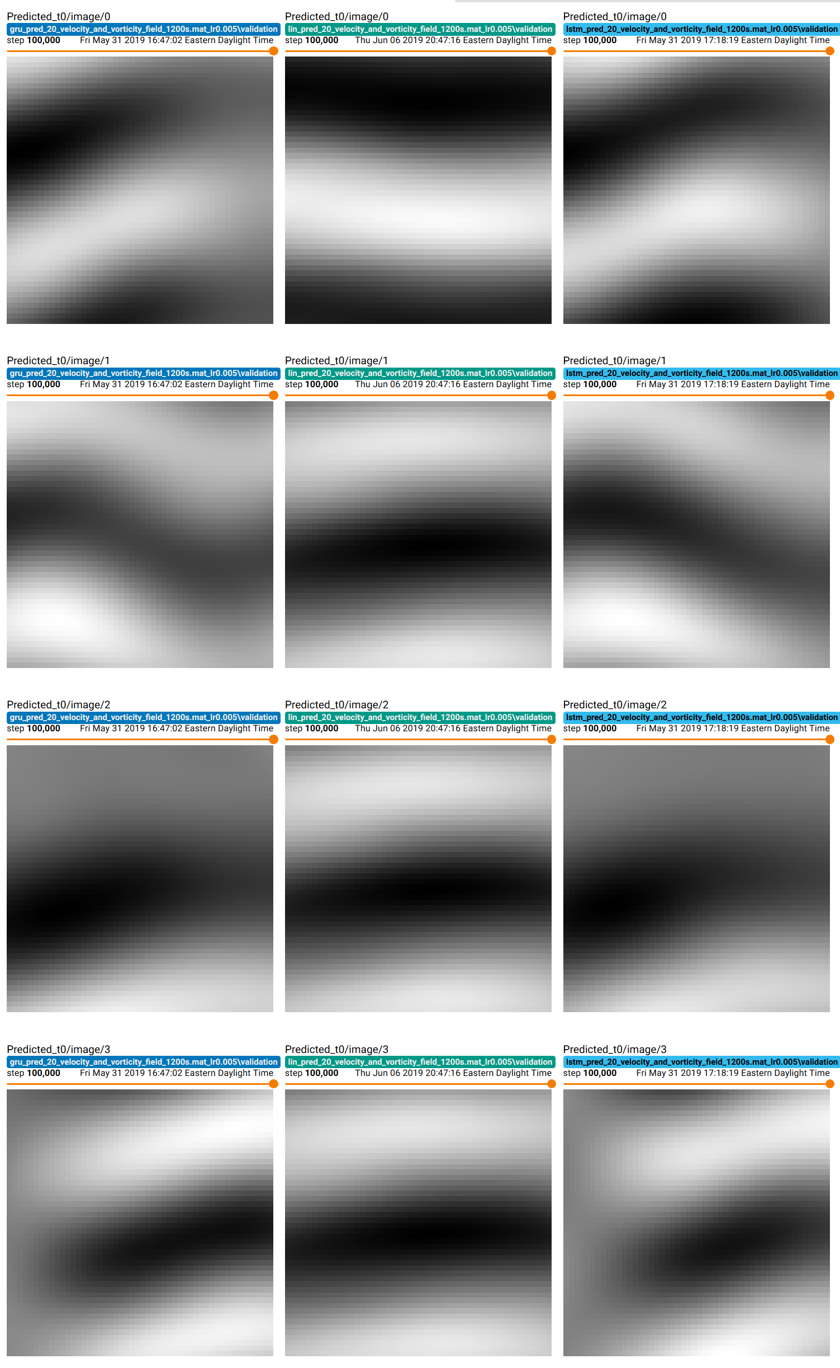
Comparing different model architectures Recurrent layer type

Slide 14
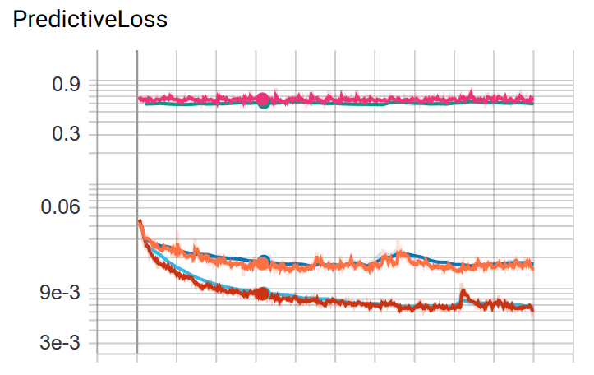
Comparing different model architectures Recurrent layer type
L2 error

Slide 15
Architecture Summary
Loss fn | L1 | L2
Random | 0.32 | 0.65
Best n=20 | 1e-4 | (1e-2)
Best n=200 | 1e-1
Fully connected neural networks
Single layer fully connected network
Triple layer fully connected network
Recurrent networks
Recurrent LSTM
1, 2, 3, 5, 10 recurrent cells
50, 250, 500 parameters per cell
Recurrent GRUs
2, 3, 5 recurrent cells
250, 500 parameters per cell

